Slide 1
CSC 334 – Parallel and Distributed Computing
Instructor: Ms. Muntha Amjad
Lecture# 03: Parallel Programming Models

Slide 2
Parallel Programming Models
There are several parallel programming models in common use:
  Shared Memory (without threads)
  Shared Memory (with threads)
  Distributed Memory / Message Passing
  Data Parallel
  Hybrid
  Single Program Multiple Data (SPMD)
  Multiple Program Multiple Data (MPMD)
Parallel programming models exist as an abstraction above hardware and memory architectures.

Slide 3
Overview
Although it might not seem apparent, these models are NOT specific to a particular type of machine or memory architecture. In fact, any of these models can (theoretically) be implemented on any underlying hardware.
Shared memory model on a distributed memory machine: Kendall Square Research (KSR) ALLCACHE approach. Machine memory was physically distributed across networked machines but appeared to the user as a single shared memory global address space. Generically, this approach is referred to as "virtual shared memory".
Distributed memory model on a shared memory machine: Message Passing Interface (MPI) on SGI Origin 2000 employed the CC-NUMA (Cache-Coherent Non-Uniform Memory Access) type of shared memory architecture, where every task has direct access to global memory. However, the ability to send and receive messages using MPI, as is commonly done over a network of distributed memory machines, was implemented and commonly used.

Slide 4
Overview
Which model to use is often a combination of what is available and personal choice. There is no "best" model, although there certainly are better implementations of some models over others.
This lecture describes each of the models mentioned above and discuss some of their actual implementations.

Slide 5
Shared Memory Model (without threads)
In this programming model, processes/tasks share a common address space, which they read and write to asynchronously, meaning that processes do not need to explicitly communicate but rather access shared data directly.
Various mechanisms such as locks / semaphores are used to control access to the shared memory, resolve contentions and to prevent race conditions (where multiple processes modify data unpredictably) and deadlocks (situations where processes wait indefinitely for resources).
This is perhaps the simplest parallel programming model.
An advantage of this model from the programmer's point of view is that the notion of data "ownership" is lacking, so there is no need to specify explicitly the communication of data between tasks. All processes see and have equal access to shared memory. Program development can often be simplified.

Slide 6
Shared Memory Model (without threads)
An important disadvantage in terms of performance is that it becomes more difficult to understand and manage data locality:
    If a process works with data that is stored close to it (e.g., in its own cache or memory), it does not need to access shared memory frequently.
    Accessing memory (especially shared memory) takes time and resources. If a process can keep the data in its local cache or memory, it avoids costly accesses to the shared memory.
    Modern processors use caches to store frequently used data. If multiple processes keep accessing the same shared data, the cache keeps refreshing (updating), which slows things down.
    In a shared memory system, processes communicate via a system bus. If many processes frequently access the same data in shared memory, the bus gets congested, leading to slowdowns.
  Unfortunately, controlling data locality is hard to understand and may be beyond the control of the average user.

Slide 7
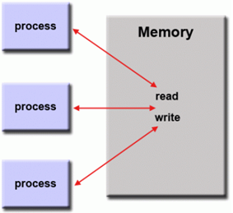
Shared Memory Model (without threads)
Implementation:
  On shared memory platforms, native operating systems, compilers and/or hardware provide support for shared memory programming. For example, the POSIX standard provides an API for using shared memory, and UNIX provides shared memory segments (shmget, shmat, shmctl, etc.).

Slide 8
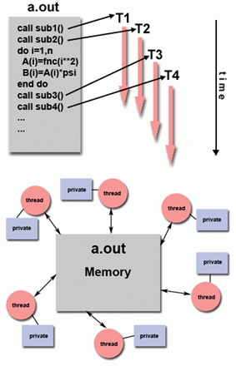
Threads Model
In this shared memory programming model, a single “heavy weight” process can have multiple “light weight” concurrent execution paths. For example:
  The operating system schedules the main program a.out which is loaded and acquires all necessary resources to run. This is the "heavy weight" process.
  a.out performs some serial work and then creates a number of tasks (threads) that can be scheduled and run by the operating system concurrently.
  Each thread has local data, but also, shares the entire resources of a.out. This saves the overhead associated with replicating a program's resources for each thread ("light weight"). Each thread also benefits from a global memory view because it shares the memory space of a.out.
  A thread's work may best be described as a subroutine within the main program. Any thread can execute any subroutine at the same time as other threads.
  Threads communicate with each other through global memory (updating address locations). This requires synchronization constructs to ensure that more than one thread is not updating the same global address at any time.
  Threads can come and go, but a.out remains present to provide the necessary shared resources until the application has completed.

Slide 9
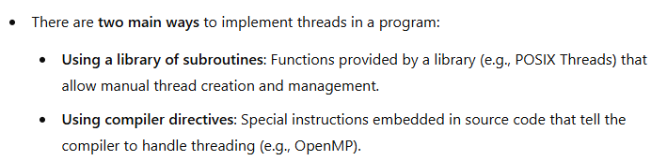
Threads Model Implementations
In both cases, the programmer is responsible for determining all parallelism.
Threaded implementations are not new in computing. In the past, hardware vendors developed their own proprietary threading methods. These implementations were incompatible with each other, making it difficult to write portable, cross-platform multithreaded programs.
Unrelated standardization efforts have resulted in two very different implementations of threads: POSIX Threads and OpenMP.

Slide 10
Threads Model Implementations
POSIX Threads:
  Specified by the IEEE POSIX 1003.1c standard (1995). C Language only
  Part of Unix/Linux operating systems
  Library based; requires parallel coding; commonly referred to as Pthreads.
  Very explicit parallelism; requires significant programmer attention to detail.
OpenMP:
  Industry standard, jointly defined and endorsed by a group of major computer hardware and software vendors, organizations and individuals.
  Compiler directive based
  Portable / multi-platform, including Unix and Windows platforms
  Available in C/C++ and Fortran implementations
  Can be very easy and simple to use – provides for "incremental parallelism“
Other common threaded implementations include Microsoft threads, Java and Python threads CUDA threads for GPUs

Slide 11
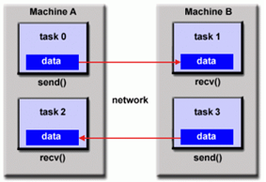
Distributed Memory/ Message Passing Model
This model demonstrates the following characteristics:
  A set of tasks that use their own local memory during computation. Multiple tasks can reside on the same physical machine and/or across an arbitrary number of machines.
  Tasks exchange data through communications by sending and receiving messages.
  Data transfer usually requires cooperative operations to be performed by each process. For example, a send operation must have a matching receive operation.

Slide 12
Message Passing Model Implementation: MPI
From a programming perspective, message passing implementations commonly comprise a library of subroutines that are imbedded in source code. The programmer is responsible for determining all parallelism.
Historically, a variety of message passing libraries have been available since the 1980s. These implementations differed substantially from each other making it difficult for programmers to develop portable applications.
In 1992, the MPI Forum was formed with the primary goal of establishing a standard interface for message passing implementations.
Part 1 of the Message Passing Interface (MPI) was released in 1994. Part 2 (MPI-2) was released in 1996.

Slide 13
Message Passing Model Implementation: MPI
MPI is the "de facto" industry standard for message passing in parallel computing.
It has replaced older message-passing implementations for production use.
MPI is available on most parallel computing platforms, ensuring wide applicability.
Different MPI versions exist (MPI-1, MPI-2, MPI-3), but not all implementations support every feature.
For shared memory architectures, MPI implementations usually don't use a network for task communications. Instead, they use shared memory (memory copies) for performance reasons.

Slide 14
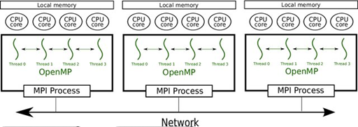
Message Passing Model Implementation: MPI
The diagram at the bottom illustrates a hybrid approach combining MPI and OpenMP:
  Each MPI process runs on a separate node in a distributed system.
  Within each node, multiple CPU cores execute OpenMP threads.
  OpenMP is used for intra-node parallelism (within a node), while MPI is used for inter-node communication (across different nodes via a network).
This hybrid approach optimizes performance by reducing communication costs.

Slide 15
Data Parallel Model
Also be referred to as the Partitioned Global Address Space (PGAS) model.
The data parallel model demonstrates the following characteristics:
  Most of the parallel work focuses on performing operations on a data set. The data set is typically organized into a common structure, such as an array or cube.
  Different tasks operate on separate portions of the same data structure. These tasks do not overlap, meaning each task is responsible for a unique chunk of data.
  All tasks perform the same computation but on different portions of the data. Example: If we need to add 4 to every element in an array, each task processes a different subset of the array.
On shared memory architectures, all tasks may have access to the data structure through global memory.
On distributed memory architectures the data structure is split up and resides as "chunks" in the local memory of each task.

Slide 16
Data Parallel Model Implementations
Currently, there are several parallel programming implementations in various stages of developments, based on the Data Parallel / PGAS model.
  Coarray Fortran: A small set of extensions to Fortran 95 for SPMD parallel programming. Compiler dependent.
  Unified Parallel C (UPC): An extension to the C programming language for SPMD parallel programming. Compiler dependent.
  Global Arrays: Provides a shared memory style programming environment in the context of distributed array data structures. Public domain library with C and Fortran77 bindings.
  X10: A PGAS based parallel programming language being developed by IBM at the Thomas J. Watson Research Center.
  Chapel: An open-source parallel programming language project being led by Cray.

Slide 17
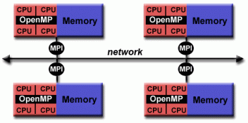
Hybrid Model
Hybrid models combine more than one of the previously described programming models.
Currently, a common example of a hybrid model is the combination of MPI with OpenMP.
  Threads perform computationally intensive kernels using local, on-node data
  Communications between processes on different nodes occurs over the network using MPI
This hybrid model lends itself well to the most popular (currently) hardware environment of clustered multi/many-core machines.

Slide 18
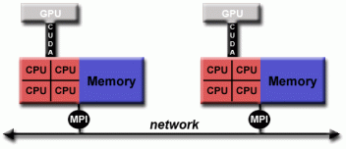
Hybrid Model
Another similar and increasingly popular example of a hybrid model is using MPI with CPU-GPU (graphics processing unit) programming.
  MPI tasks run on CPUs using local memory and communicating with each other over a network.
  Computationally intensive kernels are off-loaded to GPUs on-node.
  Data exchange between node-local memory and GPUs uses CUDA (or something equivalent).
Other hybrid models are common:
  MPI with Pthreads
  MPI with non-GPU accelerators

Slide 19

Single Program Multiple Data (SPMD)
SPMD is actually a "high level" programming model that can be built upon any combination of the previously mentioned parallel programming models.
All tasks execute their copy of the same program simultaneously. All tasks may use different data
SPMD programs usually have the necessary logic programmed into them to allow different tasks to branch or conditionally execute only those parts of the program they are designed to execute. That is, tasks do not necessarily have to execute the entire program - perhaps only a portion of it.
The SPMD model, using message passing or hybrid programming, is probably the most commonly used parallel programming model for multi-node clusters.

Slide 20

Multiple Program Multiple Data (MPMD)
Like SPMD, MPMD is actually a "high level" programming model that can be built upon any combination of the previously mentioned parallel programming models.
MPMD applications typically have multiple executable object files (programs). While the application is being run in parallel, each task can be executing the same or different program as other tasks.
All tasks may use different data

